Slide 1
NCTU DL Lab5-Conditional sequence-to-sequence VAE
TA 李仕柏
April 18, 2019

Slide 2
Outline
Lab Objective
Important Date
Lab Description
Hints
Scoring Criteria
Notes:
This course is a graduate-level course, which was first offered in spring term of 2017.
It is instructed by two other professors and me.
Back then, about 55 students were enrolled in this course.
In fact, we had a lot more students hoping to take it.
But, we could accept only 60 of them due to limited GPUs we have.
This course was concluded with a workshop in July this summer, with 26 teams presenting their final projects.
In this workshop, we also invited few experts from the industry to grade the students’ performance.
Some of them were amazed by the diversity of the students’ projects.

Slide 3
Lab Objective
In this lab, you need to implement a conditional seq2seq VAE for English tense conversion.
Tense conversion (4 tenses)
E.g. ‘access’ to ‘accessing’, or ‘accessed’ to ‘accesses’
Generative model
Gaussian noise + tense -> access, accesses, accessing, accessed

Slide 4
Important Date
Experiment Report Submission Deadline: 5/9 (Thu) 11:59 a.m
Demo date: 5/9 (Thu)
Zip all files in one file
Report (.pdf)
Source code
name it like「DLP_LAB5_yourstudentID_name.zip」
ex: 「DLP_LAB5_0756051_李仕柏.zip」

Slide 5
Lab Description
To understand sequence-to-sequence architecture
Embedding function
Teacher forcing technique
Word dropout
To understand CVAE
Reparameterization trick
Log variance
KL lost annealing
Condition

Slide 6
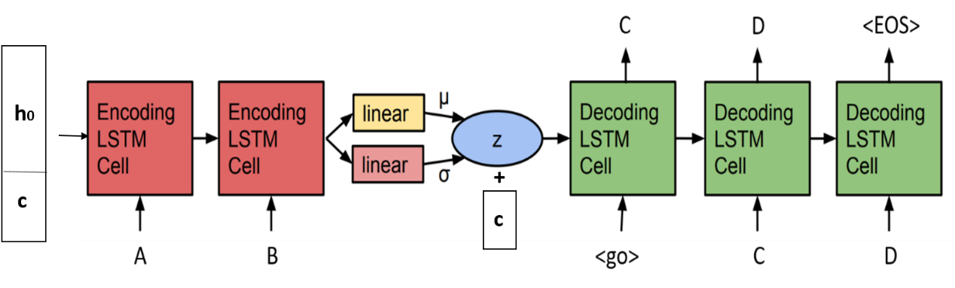
Lab Description - architecture
Input word: ‘access’
Initial input of encoder : (h_0+‘simple present’,’a’)
Initial input of decoder : (z+’present progressive’,’<go>’)

Slide 7
Lab Description – seq2seq
Embedding function (for characters and conditions)
[1,2,3] -> [shape(128), shape(128), shape(128)] (high dimensional space)
Teacher forcing
Using ground truth character instead of the output of the decoder.
Word dropout (optional)
Change the input of the decoder to <UNK> token.

Slide 8
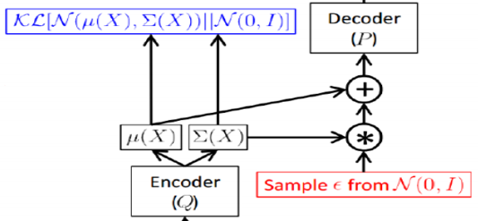
Lab Description - CVAE
Reparameterization trick
Log variance
Output should be log variance (not variance)
KL cost annealing
Initially set your KL weight to 0
Design in any way you like
Condition
Simply concatenate to the hidden_0 and z

Slide 9
Lab Description – Other details
The encoder and decoder are implemented by LSTM or GRU.
The loss function is nn.CrossEntropyLoss().
Adopt BLEU-4 score function in NLTK.

Slide 10
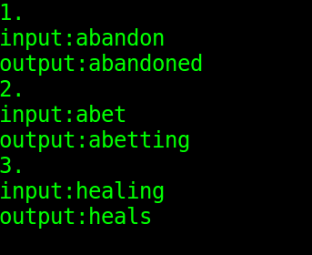
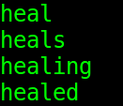
Lab Description – Requirements
Modify encoder, decoder, and training functions
Implement evaluation function, dataloader, and reparameterization trick.
Adopt teacher-forcing and kl loss annealing in your training processing.
Plot the loss, KL loss, and BLEU-4 score curve during training.
Output examples (tense conversion & Gaussian noise with 4 tenses)

Slide 11
Hints
Training method
Input the word with the tense and the output should also be the same word.
Convert each character to a number (dictionary)
Model weights
Strongly recommend you save your model weights during training
Teacher forcing ratio and KL weight
Influential to the performance of model
You can first set your KL weight to 0 to see whether your model works.

Slide 12
Scoring Criteria
Report (60%)
Introduction
Implementation details
Describe how you implement your model. (e.g. dataloader, encoder, decoder, etc)
Specify the hyperparameters (KL weight, teacher forcing ratio, etc.)
Results and discussion
Plot the loss and KL loss curve while training and discuss the results.
Plot the BLEU-4 score of your testing data while training and discuss the result.

Slide 13
Scoring Criteria
Demo(40%)
Capability of tense conversion on testing data. (10%)
Score >= 0.7 ---- 100%
0.7 > score >= 0.6 ---- 90%
0.6 > score >= 0.5 ---- 80%
Score < 0.5 ---- 70%
Capability of word generation. (Gaussian noise + tense) (10%)
You have 3 chances to randomly generate different Gaussian noises with 4 tenses. You can choose one of them as your final score.
4 correct words ---- 100%
3 correct words ---- 90%
2 correct words ---- 80%
Otherwise ---- 0%
Questions (20%)

